Slide 1
Software/Hardware Co-Design to Improve Productivity, Portability, and Performance of Loop-Task Parallel Applications
Ji Yun Kim
Computer Systems Laboratory
Cornell University
08/31/2016
Notes:
I’d like to start with a little interactive survey. I know there’s a lot of very experienced programmers here in the room today, and I’m curious to know how most of you start development on a brand new application.
Let’s say this is an emerging application that doesn’t have any existing codebase we can use as a baseline.
FPGA? MIC? GPGPU? Even before that, would you want to test for functionality and play around with the algorithm?
Most people would probably start from what they have readily available. The Intel processor in my laptop, for example.
Once we have a single-threaded implementation, what would you do next?
Any other favorite parallel programming frameworks people like? What do you like about TBB or OpenCL?
Let’s say we have an optimized CMP implementation, but unfortunately the performance is still not good enough, what would you do next?

Slide 2
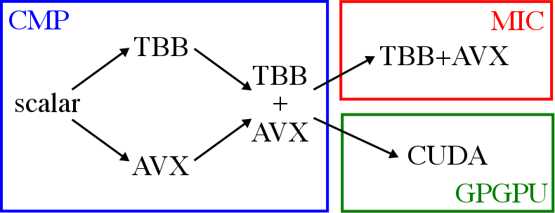
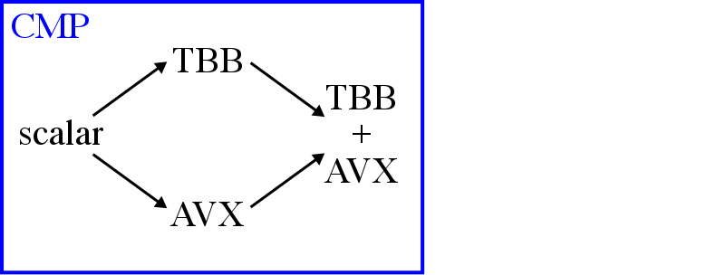
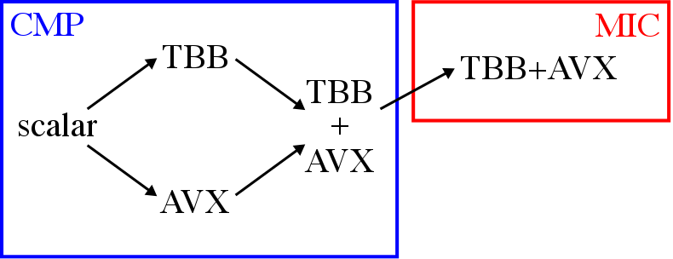
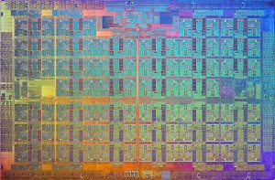
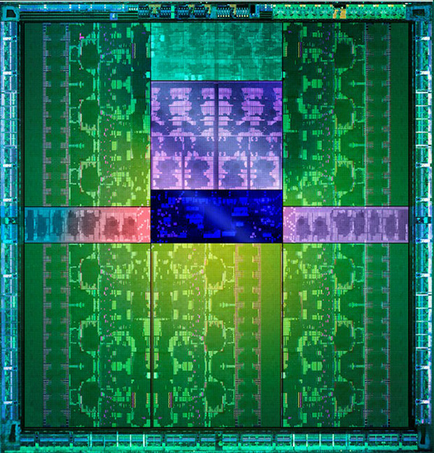
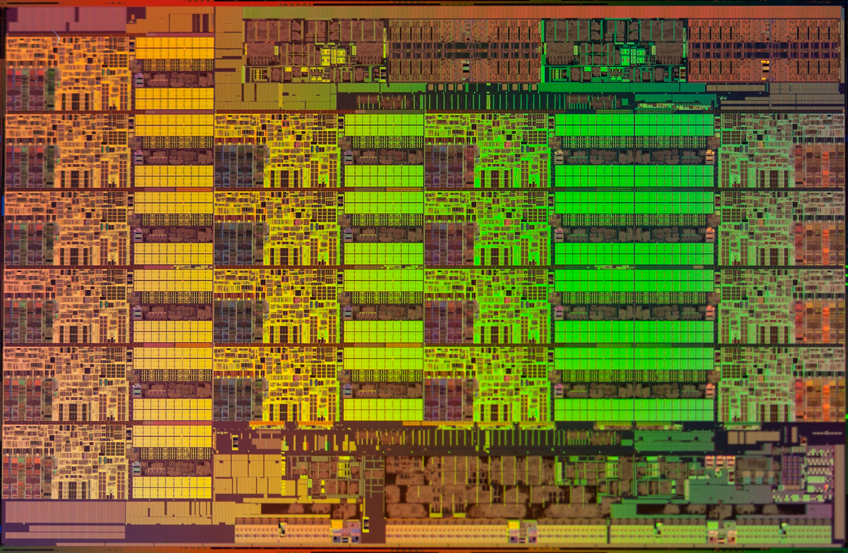
Example Application Development Flow
NVIDIA Tesla K20
Productivity
How easy is it to implement and optimize applications?
Portability
How easy is it to port applications across platforms?
Performance
How easy is it to achieve speedups for wide range of applications?
Intel Xeon E5 2600
Intel Xeon Phi 5110P
Notes:
So here’s one example of a development flow for a new application with a high-performance target, which is very similar to what we just talked about.
We might start on a CMP, like the Intel Xeon, with a single-threaded scalar implementation to test for functionality and get a better understanding of the algorithm. CMPs have at least 4 cores these days, the Xeon can have up to 16 cores. Each core is an aggressive superscalar out-of-order core with packed-SIMD units.
Then we could either attempt to vectorize the single-threaded implementation with vector extensions like AVX to leverage the packed-SIMD units on most CMPs. Auto-vectorization is the preferred method of doing this, as opposed to using vector intrinsics, but if any of you have had experience trying to get auto-vectorization to work, you will know that it is never as simple as annotating loops with pragmas. You usually need specific optimizations to get the compiler to actually generate vector instructions, like making sure data structures are aligned to the SIMD width and minimizing control flow.
Another option is to parallelize the code with a multi-threaded implementation using a parallel programming framework. There are a lot of options for parallel programming frameworks, like OpenMP or Cilk or OpenCL, but in this example I’m showing Intel TBB, one of my personal favorites. Again, parallel programming has its own set of challenges as I’m sure many of you are familiar with, and optimizing a multi-threaded implementation is rarely a trivial process. (load balancing, cache locality, synchronization)
We could also add vectorization on top of multi-threading to extract as much performance out of the CMP as possible. Does anyone have any experience with this? Unfortunately it’s not always as simple as it might seem. The challenge stems from the different abstractions used by multi-threading and vectorization; although they may be composable but they’re not always aware of each other, which can create some issues.
Now we have an optimized CMP implementation, but what if we need more performance? We might need to starting porting this application to accelerators.
One example is the Intel Many Integrated Core architecture, like the Xeon Phi (aka Knight’s Landing). MICs have up to 60 lightweight cores with very wide packed-SIMD units, which means vectorization is even more important than on CMPs. Depending on the programming frameworks we used on the CMP, we might need to switch to a framework supported by the MIC. But even if we can use the same framework, there is a non-trivial amount of retuning necessary to extract the most performance out of the accelerator. (different SIMD width, changing grain size or thread count to maximize load balancing) This can get even more complicated if we decide to use an offload model instead of a native model.
Another popular accelerator is the GPGPU, short for general-purpose graphics processing unit, like the NVIDIA Tesla series. GPGPUs have dozens of SIMT engines that execute threads in lock-step. The programming framework for GPGPUs is very different from either CMPs or MICs, some common examples include CUDA or OpenCL. GPGPUs are nice since they use a common abstraction for exploiting inter- and intra-core parallelism, but the tradeoff is that they _require_ an offload programming model which makes it more challenging to port a CMP implementation.
Both MICs and GPGPUs are really designed for applications with data parallelism or task parallelism with regular control-flow and memory-access patterns.
I think most of you will agree that the modern programmer has a lot of options in terms of available platforms: I am defining platforms in this work as a combination of a software framework and one or more hardware architectures.
And I hope I have highlighted the importance of productivity, portability, and performance (or the so-called 3P’s) in modern application development flows. <Define the 3P’s>. Performance is important, but it is only as good as the productivity/portability that allows the programmer to achieve that performance.

Slide 3


Existing Approaches to 3P Platforms
Virtual ISAs
e.g.) AMD Heterogeneous Architecture, OpenCL, C++AMP
Domain-Specific Languages (DSL)
e.g.) Halide, OptiML, Delite
SW-centric approaches for existing HW architectures
J. Ragan-Kelley, et al. Halide: A Language and Compiler for Optimizing Parallelism, Locality, and Re- computation in Image Processing Pipelines. PLDI 2013.
Heterogeneous System Architecture: A Technical Review. AMD White Paper 2012.
Notes:
There are several existing approaches to achieving a 3P platform.
Virtual ISAs, like those used in AMD HSA, are software translation layers that allow the programmer to use a single software framework (OpenCL or C++ AMP) to target multiple architectures. Although in theory this would mean a single implementation of an application could be used for any target, in practice, a non-trivial amount of target-specific optimizations are required to achieve high performance on a given architecture.
DSLs, like Halide, are software frameworks specialized for a narrower application domain (like image processing), that leverages domain-specific abstractions to improve the 3P’s. However, this comes at the cost of generality of the applications that can use this framework. Even Halide has separate programming models for CMPs and GPGPUs.
Note that both of these examples are software-centric approaches that are designed to be used with a given set of hardware architectures. These approaches do a great job of unifying parallel abstractions for the programmer, but rely on software translation to map these abstractions to hardware, which can limit efficiency.

Slide 4
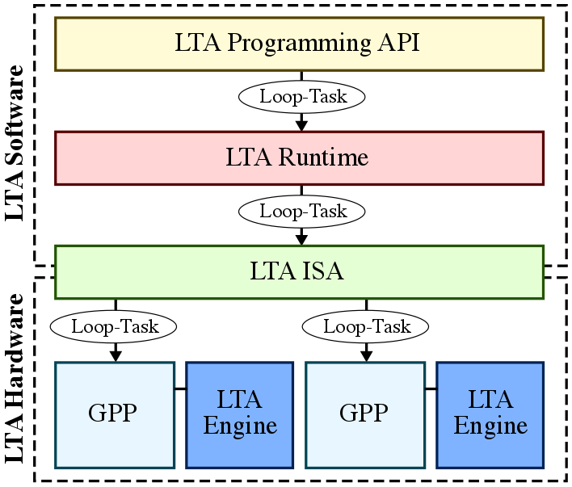
Loop-Task Accelerator (LTA) Vision
Notes:
However, what if we could push these common parallel abstractions down to the hardware and design a new architecture that can directly exploit them?
(The hypothesis is this: a software/hardware co-design approach offers the best chance of achieving a true 3P platform. What would such a platform look like?)
This leads us to the loop-task accelerator platform, my proposal for a software/hardware co-design approach for a 3P platform. The LTA platform is focuses on efficiently exploiting loop-task parallelism, a form of task parallelism exposed by the parallel_for construct, both across cores and within a core. This is done by exposing loop-tasks as the common abstraction a the programming API, runtime, ISA, and microarchitectural levels to achieve high performance, high portability, and high performance for a diverse range of loop-task parallelism.

Slide 5
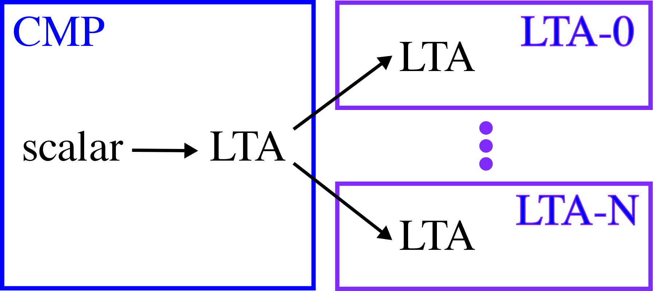
LTA Application Development Flow
Single target-agnostic implementation
Less reliance on target-specific optimizations
High performance on regular and irregular applications
Notes:
Here is what the application development flow might look like using the LTA platform.
We would still start with a scalar implementation before using the LTA parallel programming framework to write a multi-threaded implementation on the CMP.
Furthermore, we can write and compile this implementation once and run the application on a variety of LTA-supported architectures and achieve high performance on both regular and irregular applications.
Pushing the common abstraction down to the physical ISA level facilitates efficient fine-grain load balancing in homogeneous or heterogeneous systems.

Slide 6
Presentation Overview
App Dev Case Study
LTA Software
LTA Hardware
LTA Evaluation
Related Works
Conclusions

Slide 7
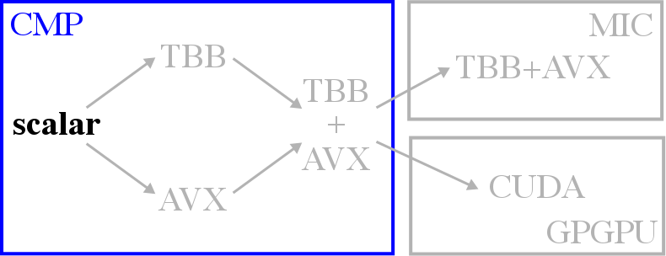
void rgb2cmyk_cmp_scalar(int size,
RgbPixel** src, CmykPixel** dst) {
for (int i = 0; i < size; i++) {
for (int j = 0; j < size; j++) {
// Calculate intermediate values
byte tmp_c = 255 - src[i][j].r;
byte tmp_m = 255 - src[i][j].g;
byte tmp_y = 255 - src[i][j].b;
byte tmp_k = std::min(
tmp_c, tmp_m, tmp_y);
// Store results into output array
dst[i][j].k = tmp_k;
dst[i][j].c = tmp_c - tmp_k;
dst[i][j].m = tmp_m - tmp_k;
dst[i][j].y = tmp_y - tmp_k;
}
}
}
Notes:
Simple color conversion application kernel. RgbPixel has three field: red, green, blue. CmykPixel has four fields: cyan, magenta, yellow, black. Convert each pixel from RGB color space to CMYK color space. Localized computation, no inter-pixel dependencies.

Slide 8
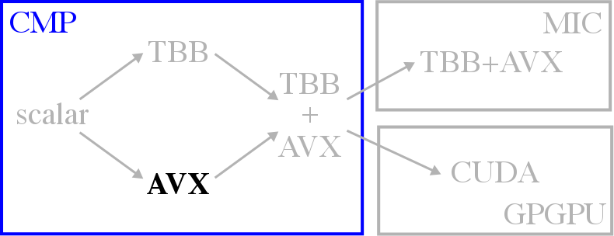
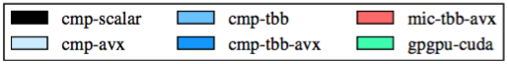
void rgb2cmyk_cmp_avx(int size,
RgbPixel** src, CmykPixel** dst) {
// Pack data into aligned arrays
byte* __restrict__ aligned_r =
(byte*)memalign(NBYTES, SIMD_WIDTH);
...
pack_aligned(src,
aligned_r, aligned_g, aligned_b);
__assume_aligned(aligned_r, SIMD_WIDTH);
...
// Vectorize within a row
for (int i = 0; i < size; i++) {
#pragma simd vlen(SIMD_WIDTH)
for (int j = 0; j < alsize; j++) {
...
byte tmp_c = 255 – aligned_r[i][j];
...
}
}}
byte min_nobranch(byte a, byte b) {
byte diff = a – b;
byte a_min = diff >> (sizeof(byte) – 1);
return b + a_min * diff;
}
Notes:
Successful auto-vectorization frequently requires a separate set of optimizations. Ensuring aligned memory accesses and eliminating control flow are the most important.
The strategy here is to vectorize computation across multiple elements within a row, thus we annotate the innermost loop with a pragma.
If we look at the performance results, we see that only the application kernels with regular control and memory access patterns show any meaningful benefit. Even across regular application kernels, the speedup depends on several factors like memory-boundness, and the actual degree of regularity.
In the case of mriq, converting branches into arithmetic for the sin/cos functions actually create more work (less computationally efficient) which can offset the speedup to an extent.
Since AVX2 supports 256b-wide packed-SIMD units, the ideal speedup would be 8 if the application is perfectly compute-bound. Obviously this is rarely the case, but sgemm and rgb2cmyk do approach this upper bound.

Slide 9
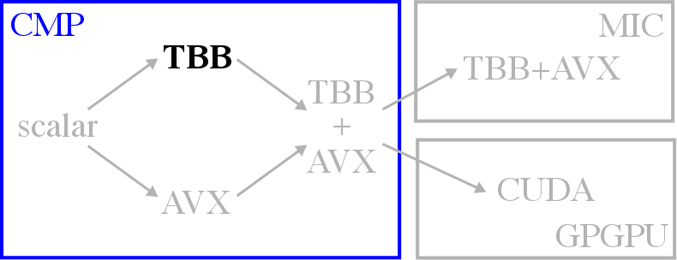
void rgb2cmyk_cmp_tbb(int size,
RgbPixel** src, CmykPixel** dst) {
// Flatten matrices
flatten(fsrc, src);
// Parallelize across elements (flat)
parallel_for (
range(0, size*size, TASK_SIZE),
[&] (range r) {
for (int i = r.begin();
i < r.end(); i++) {
// Calculate intermediate values
byte tmp_c = 255 - fsrc[i].r;
byte tmp_m = 255 - fsrc[i].g;
byte tmp_y = 255 - fsrc[i].b;
byte tmp_k = std::min(
tmp_c, tmp_m, tmp_y);
// Store results into output array
fdst[i].k = tmp_k;
fdst[i].c = tmp_c - tmp_k;
fdst[i].m = tmp_m - tmp_k;
fdst[i].y = tmp_y - tmp_k;
}
});
}
Notes:
Although there are a lot of options for parallel programming frameworks, in this study I am using Intel TBB.
TBB is good for several reasons: it offers a productive task-based programming model, it has a library-based implementation (making it more portable, no compiler modifications required), and supports dynamic work-stealing. Without going into too much detail about work-stealing, there have been a large body of work on the efficiency of pull-based models vs. push-based models, which allows for better load balancing.
There are several ways we can parallelize computation, but in this example, I am flattening the input matrix and parallelizing computation across individual elements. Another way to do this would be to parallelize computation across rows, but I found that in many cases having finer-grain tasks improves performance by increasing opportunities for load balancing. For example, in this example, there was roughly a 14% improvement in performance by flattening the matrix.
Notice the TASK_SIZE variable here. This is called the grain size in TBB and is used to hint to the runtime’s task partitioner what the final task size should be. Let me emphasize that this is a hint, and doesn’t guarantee exact task sizes due to recursive decomposition algorithm used by the runtime.
In terms or performance, we see reasonable speedups for both regular and irregular applications. Remember that this is multi-threading without vectorization. In the case of bfs-nd, the lower speedup is actually due to synchronization overheads from fine-grain locking (using AMOs).

Slide 10
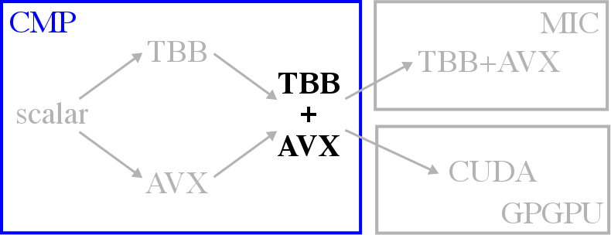
void rgb2cmyk_cmp_tbb_avx(int size,
RgbPixel** src, CmykPixel** dst) {
// Pack data into aligned arrays
...
// Parallelize across rows
parallel_for (
range(0, size, TASK_SIZE),
[&] (range r) {
for (int i = r.begin();
i < r.end(); i++) {
// Vectorize within a row
#pragma simd vlen(SIMD_WIDTH)
for (int j = 0; j < alsize; j++) {
...
byte tmp_y = 255 – aligned_b[i][j];
byte tmp_k = min_nobranch(
tmp_c, tmp_m, tmp_y);
...
}
}
});
}
Notes:
The next point in the development flow is combining multi-threading across cores using TBB and vectorization within a core using AVX.
Theoretically, this implementation should extract the most performance out of the CMP by utilizing more resources. However, in practice, this is not always the case, as we can see in dct8x8m, mriq, and rgb2cmyk. Irregular application kernels which didn’t see any benefit from vectorization before expectedly do not show any change by adding AVX to TBB.
In general, this behavior can be attributed to two reasons. First, task partitioning with TBB limits auto-vectorization…. Because of this, it may be desirable to parallelize computation across coarser-grain rows rather than flattening the matrix (which we saw yielded better performance). Second, eliminating control flow to enable AVX can limit load balancing with TBB… Because of this, the work efficiency of the combined implementation might be worse than a purely TBB implementation. For example, in mriq, profiling the TBB implementation with and without this optimization results in a 75% increase in the number of dynamic instructions.
In some cases, the closure of the lambda/functor used by TBB’s parallel_for can actually confuse the compiler about the alignment of arrays that were explicitly aligned, which can generate much less efficient unaligned loads/stores or gathers/scatters.

Slide 11
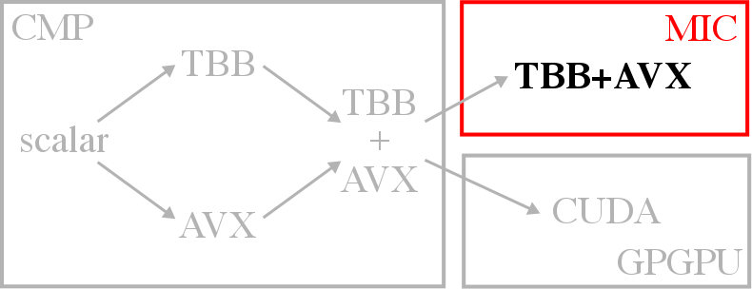
void rgb2cmyk_mic_tbb_avx(int size,
RgbPixel** src, CmykPixel** dst) {
// Pack data into aligned arrays
...
// Parallelize across chunks
parallel_for (
range(0, size*NCHUNKS, TASK_SIZE),
[&] (range r) {
for (int ri = r.begin();
ri < r.end(); ri++) {
// Calculate chunk offsets
int i = ri / NCHUNKS;
int i_off = ri % NCHUNKS;
int j_s = i_off * CHUNK_SIZE;
int j_e = j_s + CHUNK_SIZE;
// Vectorize within a chunk
#pragma simd vlen(SIMD_WIDTH)
for (int j = j_s; j < j_e; j++) {
...
byte tmp_y = 255 – aligned_b[i][j];
byte tmp_k = min_nobranch(
tmp_c, tmp_m, tmp_y);
...
}
}
});
}
Notes:
MICs can be programmed in offload mode or native mode. There are tradeoffs with each approach but in this study we focus on the more productive native model.
Much of the performance of the MIC is locked in the packed-SIMD units so it becomes even more important to enable vectorization as much as possible.
In addition, load balancing also becomes increasingly important when there are 60+ cores. As such, we might need to restructure the code to enable both finer-grain tasks as well as vectorization. One way to do this is to split rows into SIMD-width-aligned chunks and parallelize computation across these chunks. We need to guarantee that the chunks are multiples of the SIMD-width so the compiler can assume every task accesses SIMD-width-aligned memory. For example, not doing this additional chunking on the MIC can result in performance worse than the CMP (3.5x slowdown comparing with and without chunking).
Other parameters also need to be retuned for the MIC (different from the CMP): the grain size will be different as well as the number of threads. Each MIC core supports 4 physical threads (not SMT), but the maximum number of threads does not always yield the highest performance. Optimal number of threads are usually 3—4 threads per core.
We see performance for both regular and irregular, although the most significant improvements are for those that can utilize the packed-SIMD units efficiently. Otherwise, the sheer increase in the number of cores can still benefit more irregular applications.

Slide 12
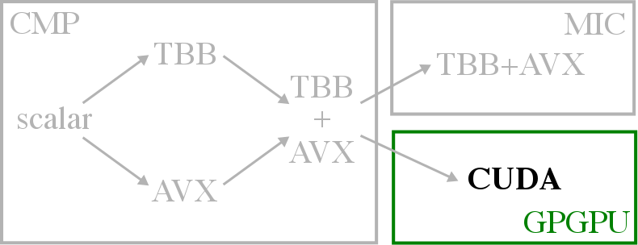
__global__ void rgb2cmyk_kernel(int size,
byte* src_r, ..., byte* dst_c, ...) {
// Calculate index
int i = blkIdx.y * BSIZE + thdIdx.y;
int j = blkIdx.x * BSIZE + thdIdx.x;
if (i >= size || j >= size) return;
...
}
void rgb2cmyk_gpgpu_cuda(int size,
RgbPixel** src, CmykPixel** dst) {
// Allocate device memory, copy data
byte* src_r, d_src_r;
...
unpack_arrays(src,
src_r, src_g, src_b);
cudaMalloc((void**)&d_src_r, NBYTES);
cudaMemcpy(d_src_r, src_r, NBYTES, HtoD);
...
// Invoke kernel on device
rgb2cmyk_kernel<<<grid,block>>>(
size, d_src_r, ..., d_dst_c, ...);
// Copy results to output
cudaMemcpy(dst_c, d_dst_c, NBYTES, DtoH);
...
pack_arrays(dst,
dst_c, dst_m, dst_y, dst_k);
}
Notes:
GPGPUs use an offload programming model (CUDA, OpenCL) which is vastly different from the other frameworks we’ve seen so far. Offload models generally require explicit memory allocation and transfer between the host and the device. Arguments need to be captured manually and there are restrictions on the types of data structures that can be used as arguments. Block/grid sizes need to be set manually and GPGPUs do not support work-stealing (they use a hardware work scheduler). There are also limitations on STL data types that can be used inside the kernel (although libraries like Thrust help this issue).
Even when using OpenCL, there are many non-trivial differences between the CMP-specific and GPGPU-specific optimizations. Need to know microarchitectural details… efficient use of texture/shared memory.
Although a regular application is shown as an example, the real challenge in terms of the 3P’s on GPGPUs is with mapping irregular applications, especially those with inter-thread communication. Barriers can lead to deadlock and AMOs for fine-grain locking across thousands of CUDA threads can significantly hamper performance.

Slide 13
Key Takeaways
Most platforms have low productivity (except CMP-TBB)
Low portability even using the same SW framework
Inter-core * intra-core parallelism != multiplicative effect
Performance on irregular apps not resource-proportional
Productivity of TBB for all inter-/intra-core parallelism
Portability that allows single implementation on all targets
Better guarantee of high performance on regular/irregular

Slide 14
Presentation Overview
App Dev Case Study
LTA Software
LTA Hardware
LTA Evaluation
Related Works
Conclusions
Notes:
The proposed LTA platform proposes to achieve these goals by using loop-tasks as a common parallel abstraction and pushing this abstraction from software down to the hardware.

Slide 15
Loop-Task Parallelism
Form of task parallelism exposed by parallel_for
Variability across loop iterations due to data-dependent branches
Encode loop-tasks as a four-tuple:
lta::parallel_for(0, size, [&](int i) {
if (src[i].cond0)
dst[i] = task0();
else if (src[i].cond1)
dst[i] = task1();
});
Notes:
One way we can do this is by narrowing the scope of the parallelism supported by the software. Instead of supporting the more generic task parallelism, I chose to focus on the a more specific form of task parallelism exposed by the popular and familiar parallel_for construct.
This is the parallelism of being able to execute loop iterations in parallel. Note that this captures a more traditional data parallelism when there is regular control flow and memory accesses across the loop iterations, but also captures what is closer to task parallelism when there is enough irregularity in control flow that each loop iteration can be considered a different task.
Why loop-task parallelism? One observation from looking at related work is that narrowing the scope of the parallel abstraction in SW allows us to more efficient encode this abstraction into a form HW can understand (see DSLs). Ideally, we would be able to encode all sorts of other parallel abstractions but that would complicate pushing this abstraction down the computing stack. So we choose loop-task parallelism since parallel_for constructs are popular and familiar. Of course, this is meant to be a first step towards a 3P platform using SW/HW codesign, so there is definitely room for others to explore how they can broaden the scope and maintain efficiency.

Slide 16
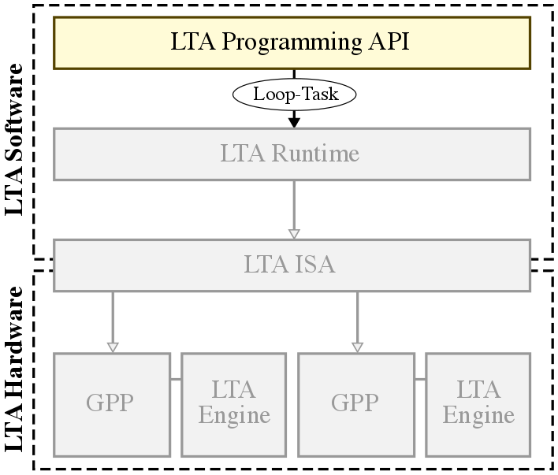
LTA Programming API
lta::parallel_for(0, size, [&](int i) {
if (src[i].cond0)
dst[i] = task0();
else if (src[i].cond1)
dst[i] = task1();
});
LTA_PARALLEL_FOR(0, size, (dst, src) ({
if (src[i].cond0)
dst[i] = task0();
else if (src[i].cond1)
dst[i] = task1();
}));
Notes:
Now let’s look at how these loop-tasks are exposed in the LTA programming API.
The lambda-based parallel_for was also explored, but unfortunately our cross-compiler does not support C++11 lambdas yet, so in this work I focus on the macro-based variant.

Slide 17
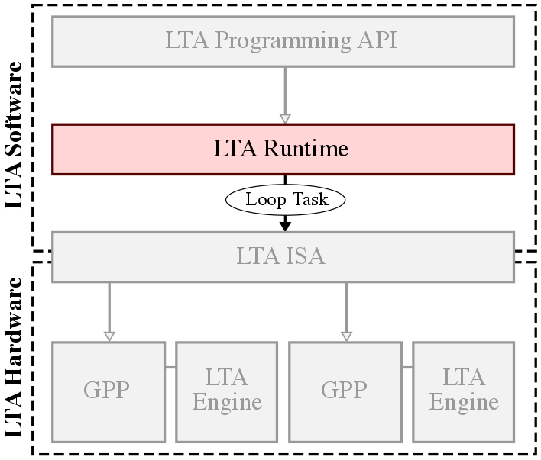
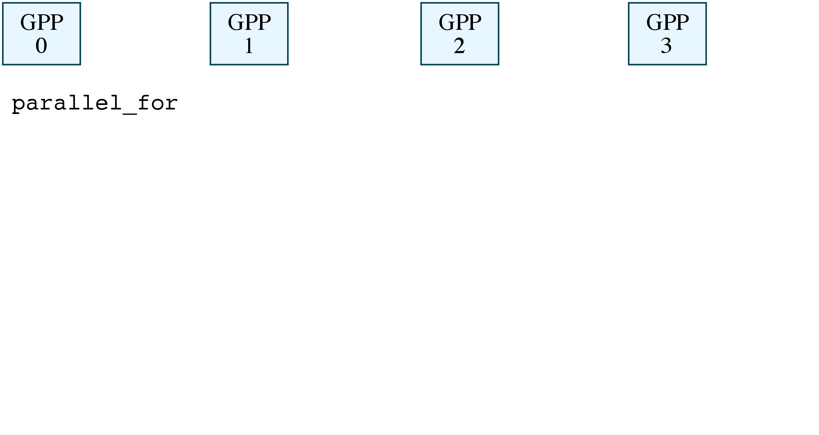
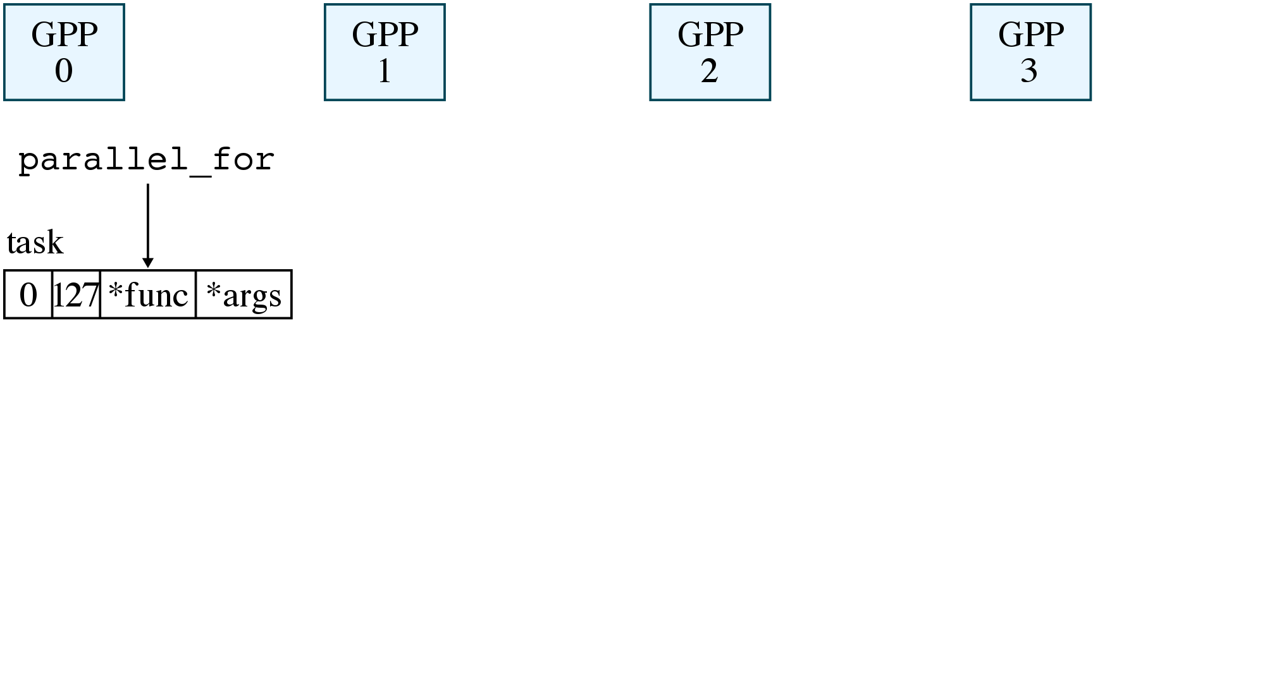
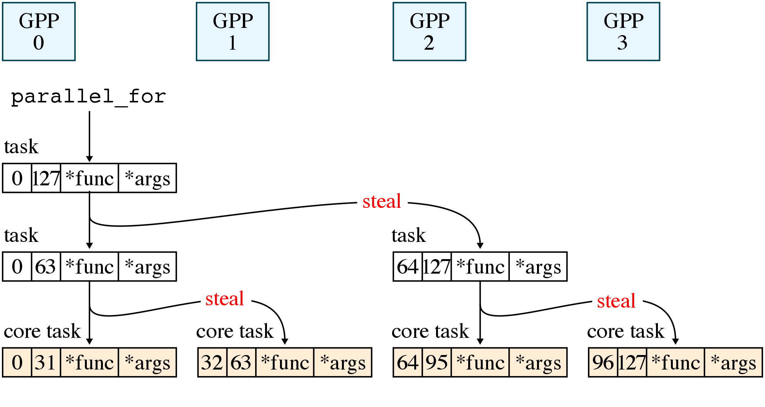

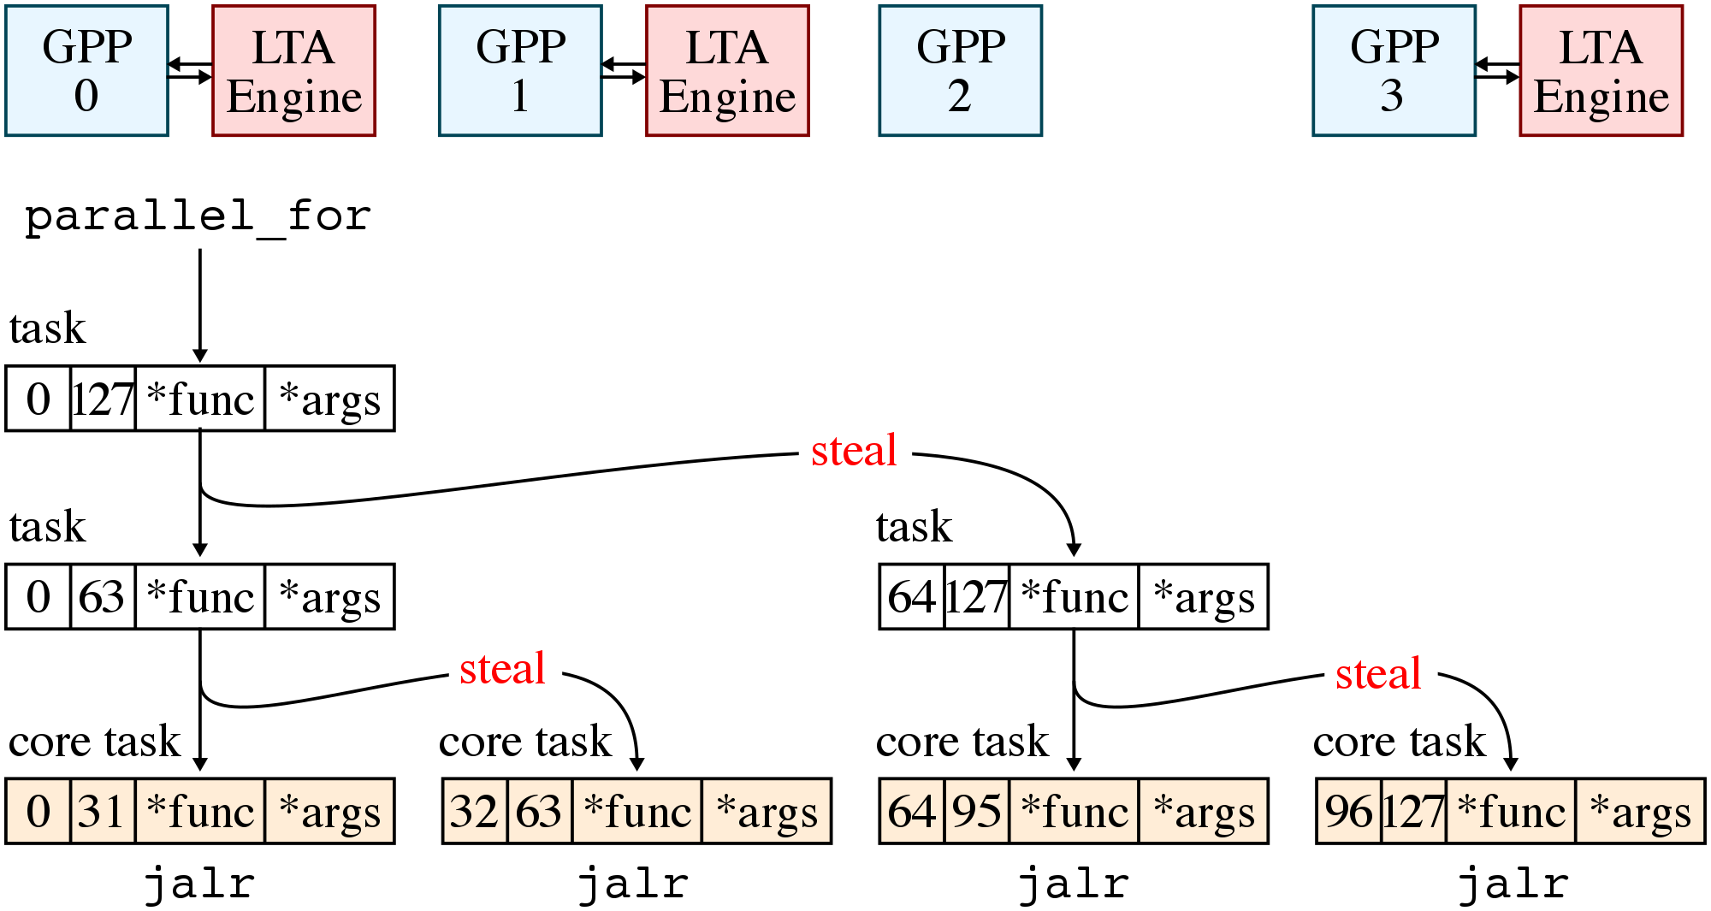
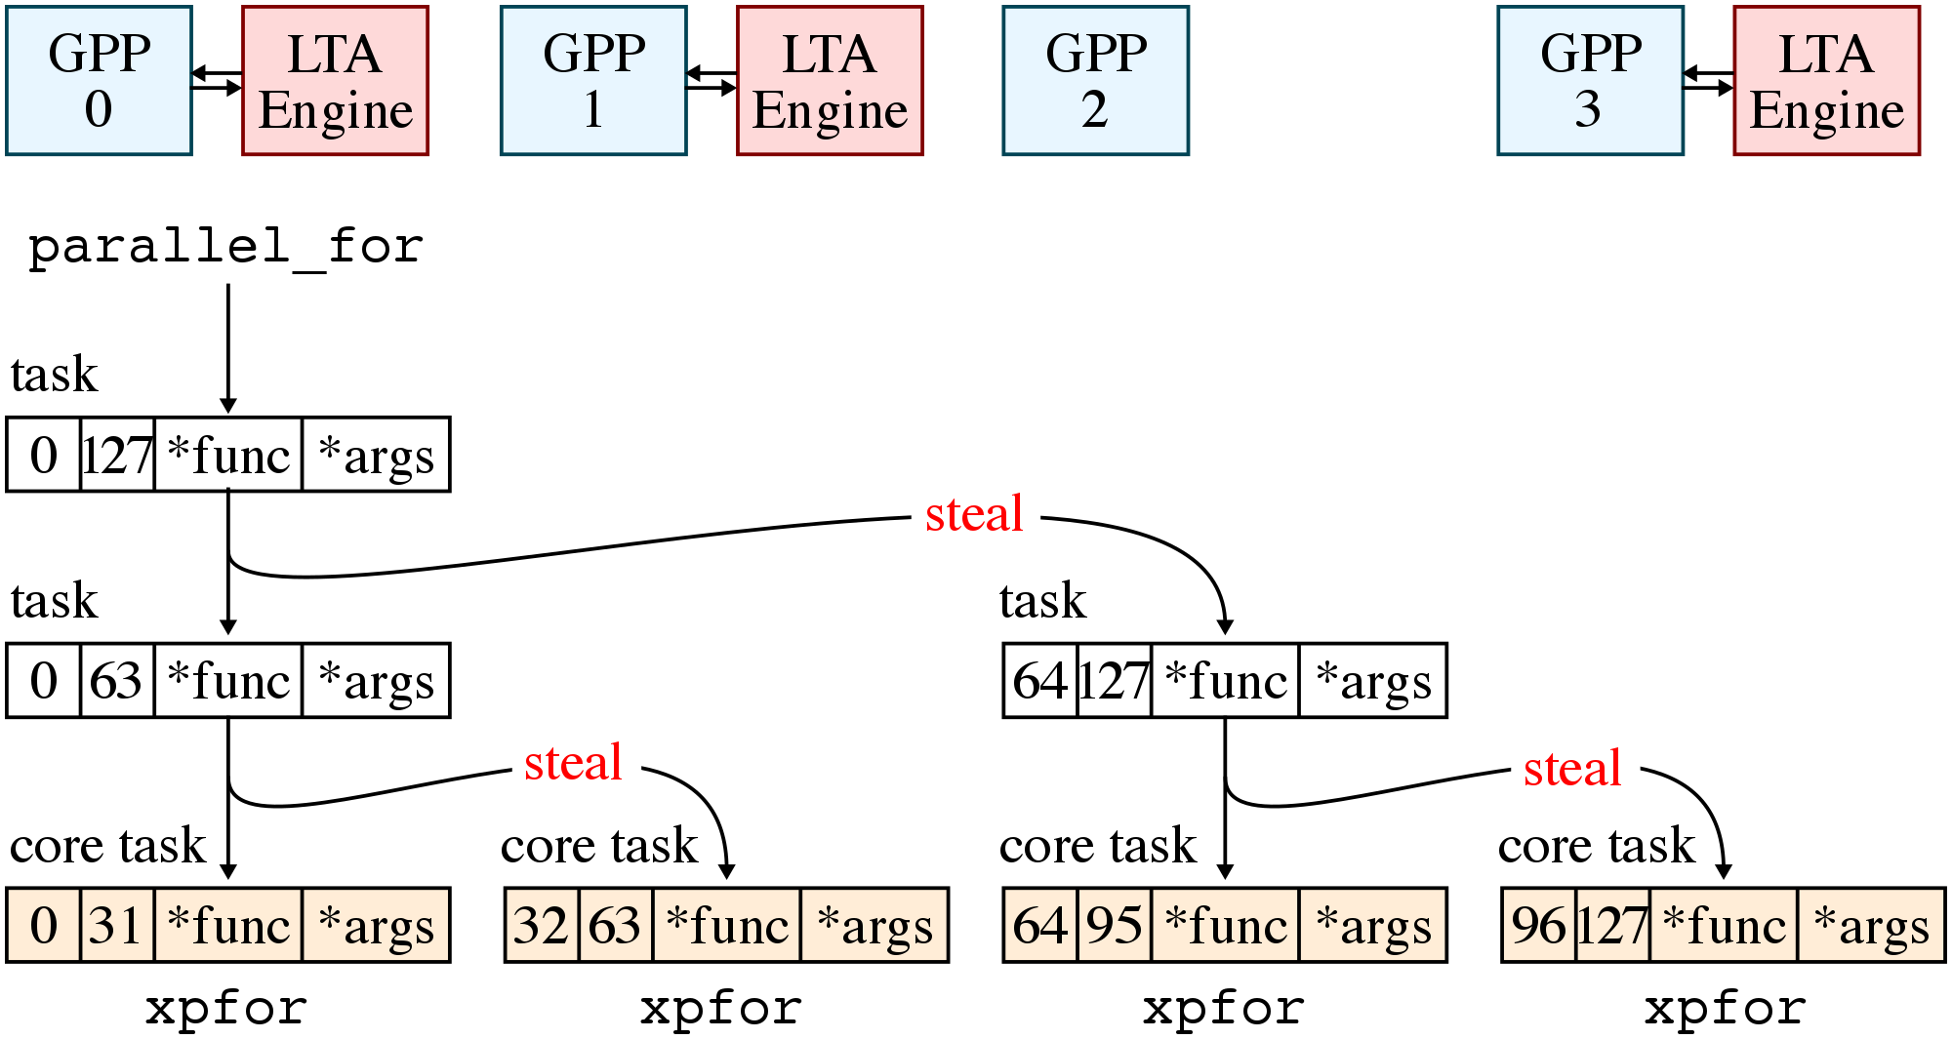
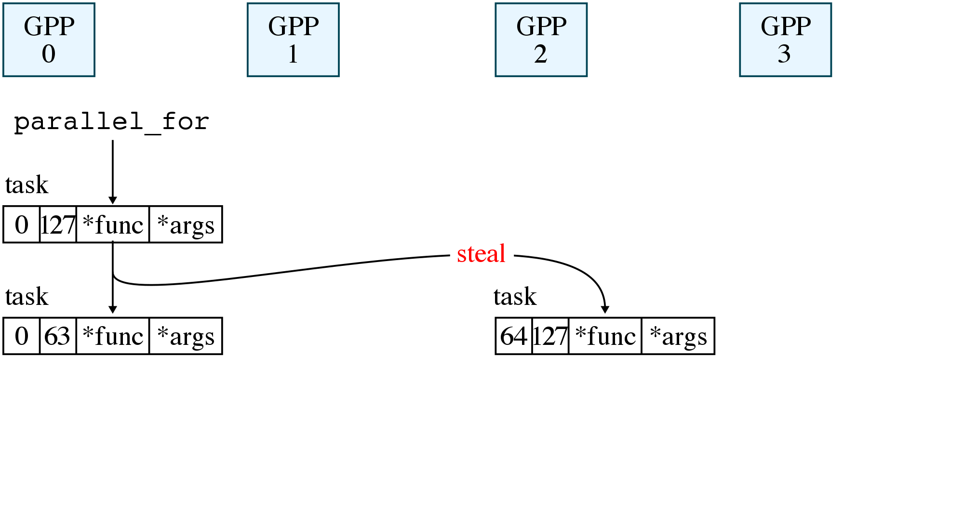
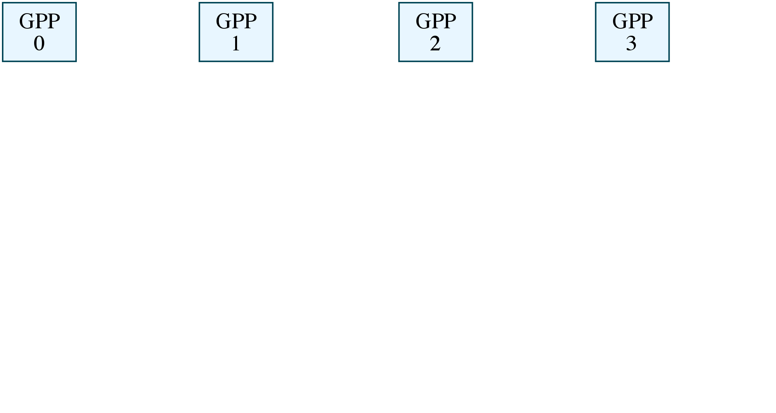
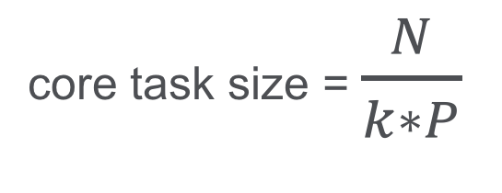
LTA Runtime
core task size = $\frac{N}{k∗P}$
Notes:
Now let’s take a look at how the runtime generates and partitions loop tasks across a multi-core system.
The master core, GPP0, begins execution of the binary while the other cores spin on a work-stealing loop in the runtime. When GPP0 encounters a parallel_for, it generates a loop-task object that contains the pointer to the function, the arguments, and the start and end indices of the initial range. We call this first loop task the root task.
GPP0 partitions the root task into two loop tasks by splitting the range in half, before pushing these loop tasks into its task queue in memory…
The runtime stops partitioning once a core task size is reached, at which point the loop tasks are called core tasks.

Slide 18
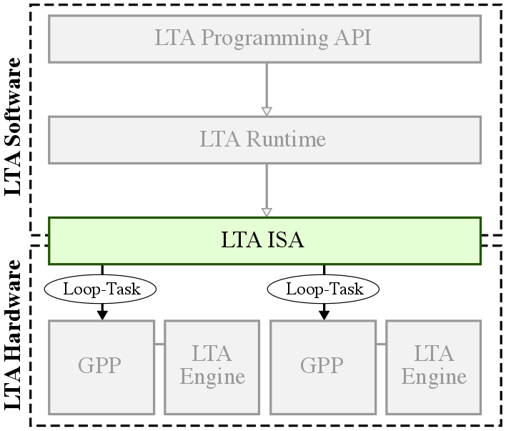
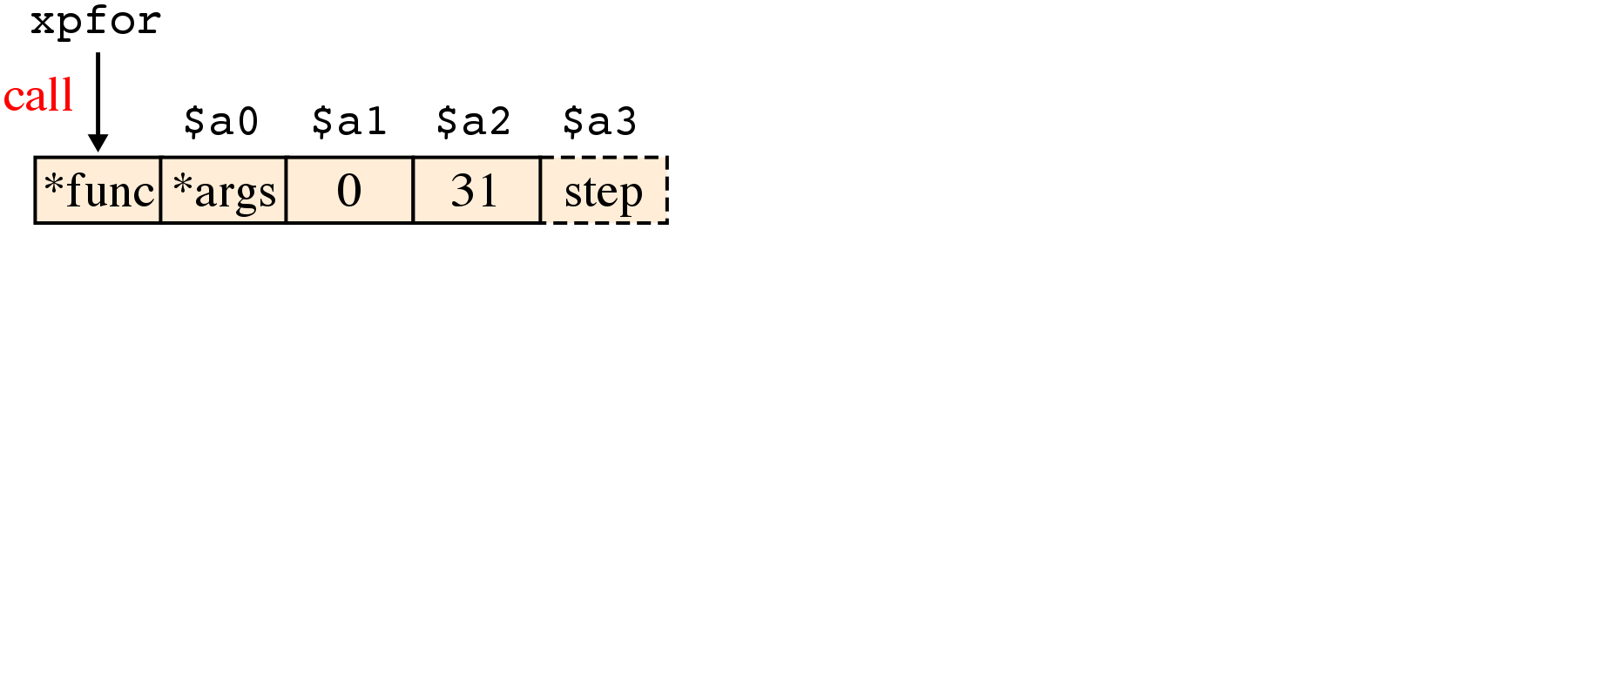
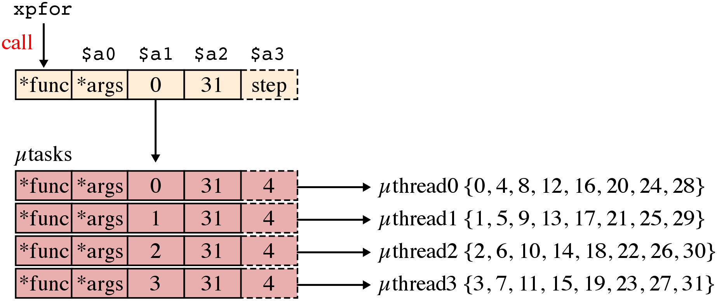
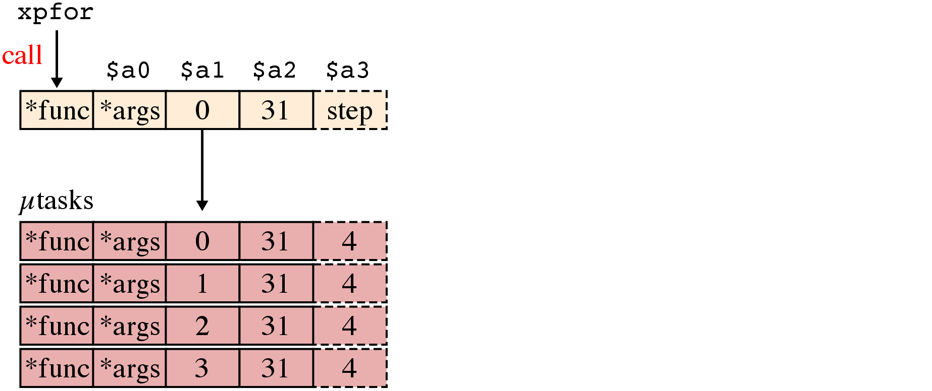
LTA ISA
void lta_function(
void* a, // $a0
int start, // $a1
int end, // $a2
int step=1 // $a3
) { ... }
xpfor has same semantics as jalr
Map µtasks to µthreads to accelerate execution
LTA runtime uses µthread-aware task partitioning
Notes:
Each uthread is assigned one utask, and utasks can be grouped into task groups that must execute in lock-step.

Slide 19
Presentation Overview
Motivating 3P Platforms
LTA Software
LTA Hardware
LTA Evaluation
Related Works
Conclusions
Notes:
So far I have described how the loop-task abstraction is exposed in the SW through the programming API, runtime, and ISA. Now I would like to talk about the hardware side of this co-design approach for a 3P platform by describing how loop tasks encoded in the xpfor instruction can be executed by the LTA engine to accelerate both regular and/or irregular applications.

Slide 20
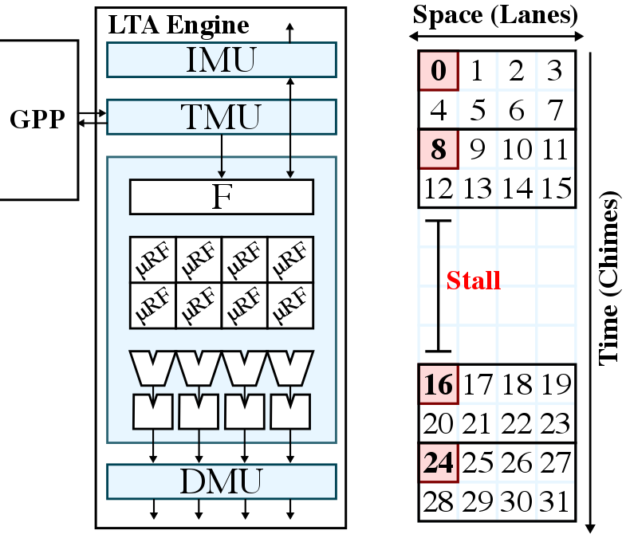
Tightly Coupled LTA Engine

Slide 21
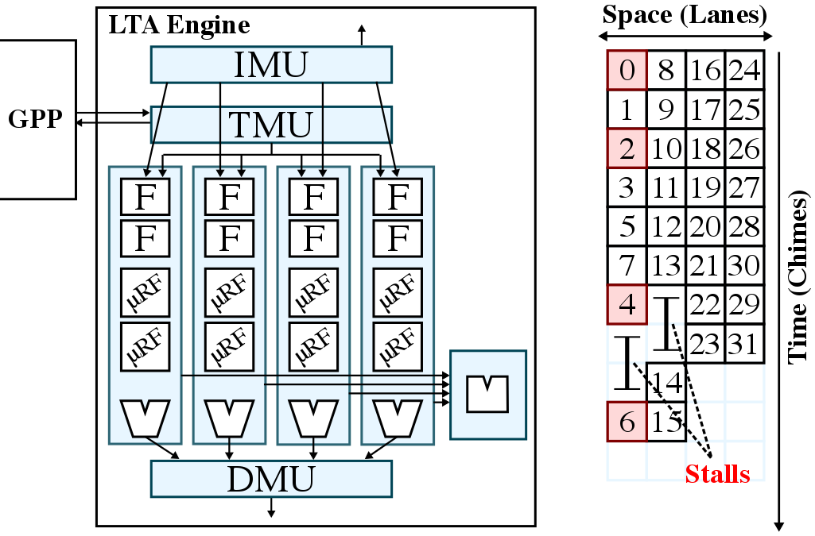
Loosely Coupled LTA Engine

Slide 22
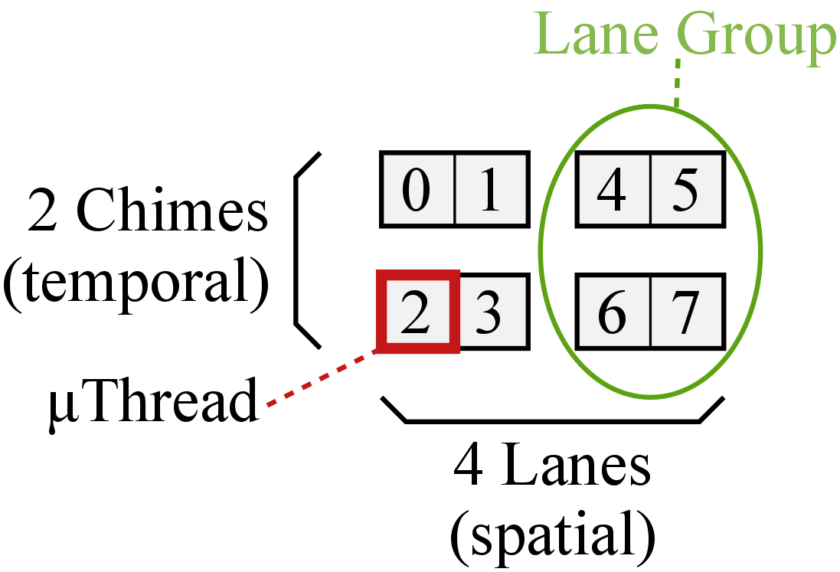
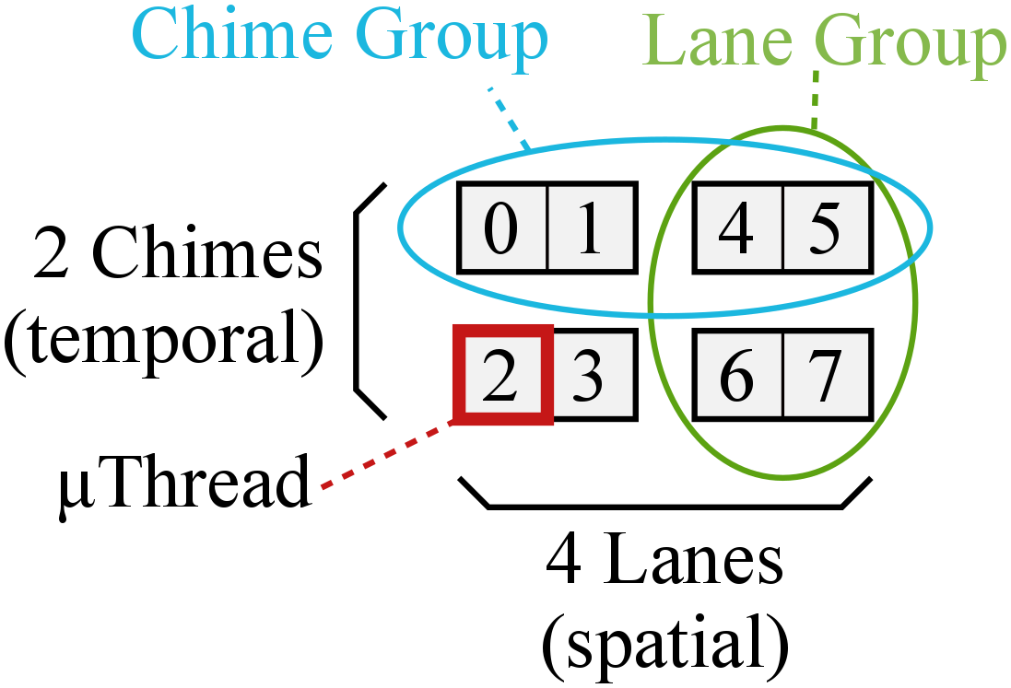
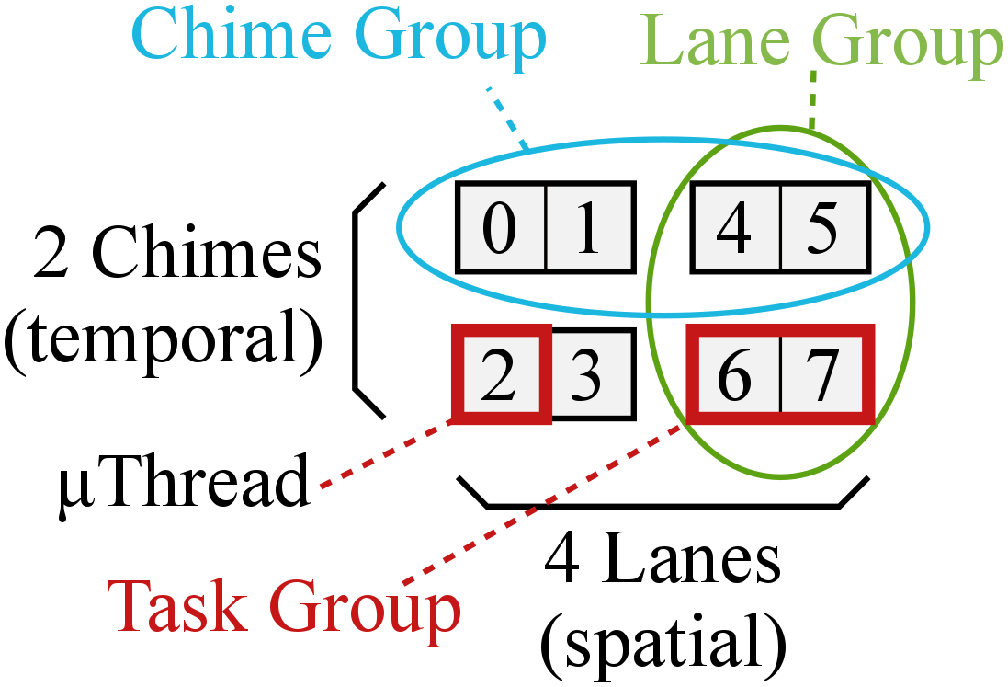
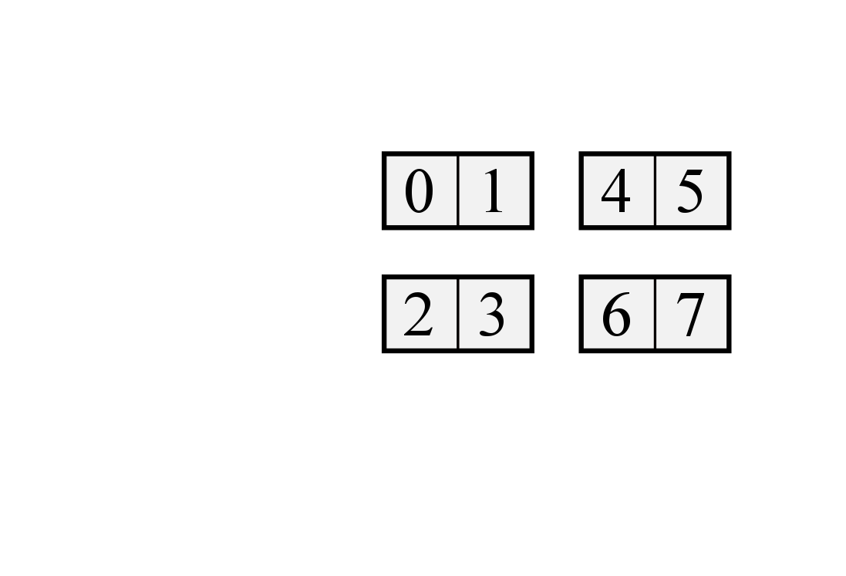
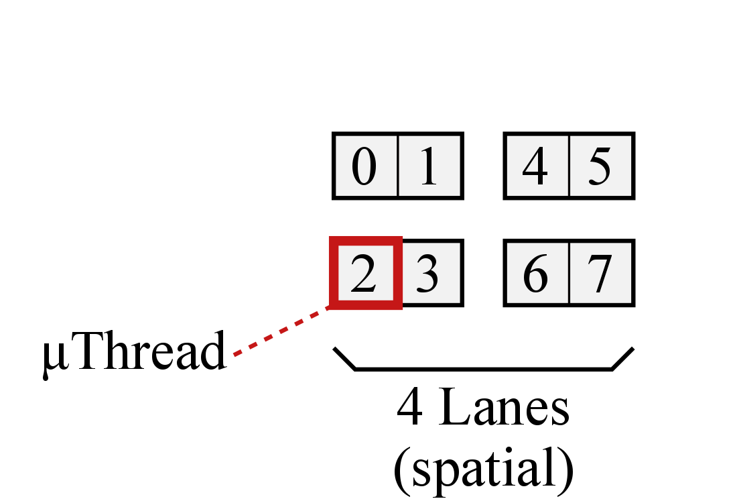
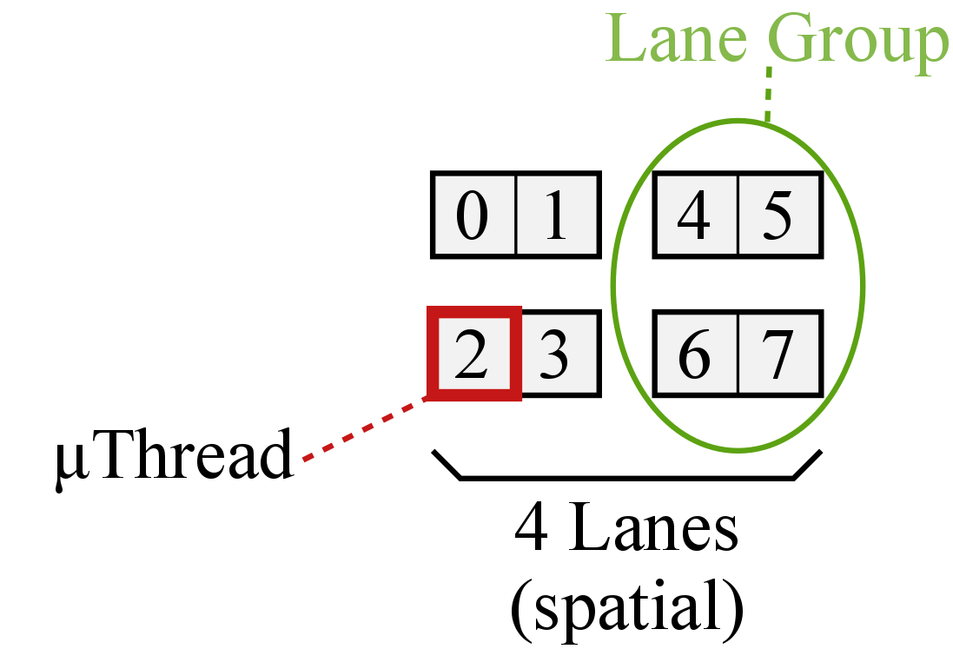
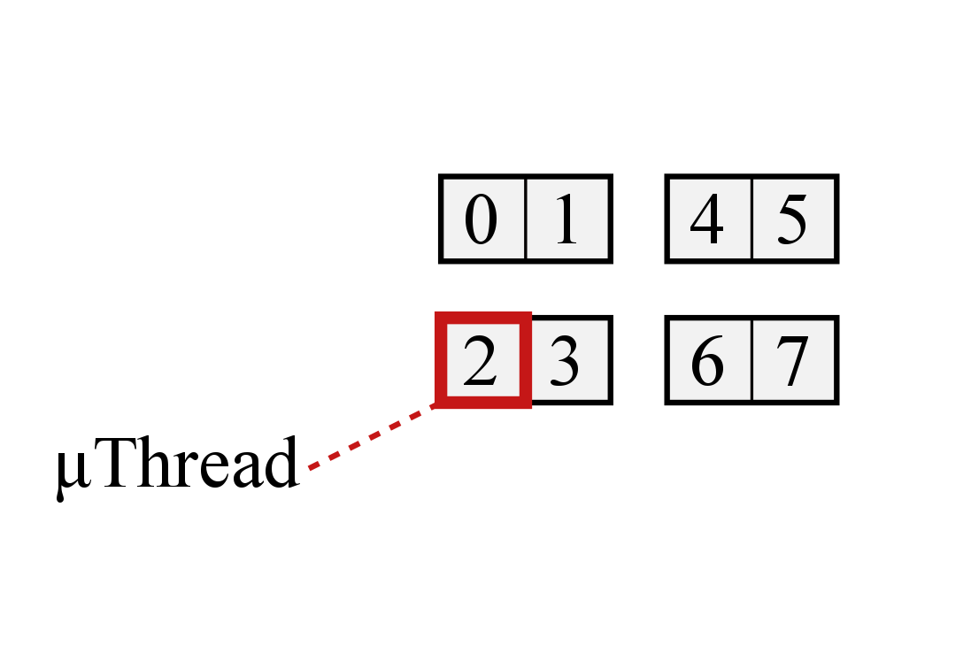
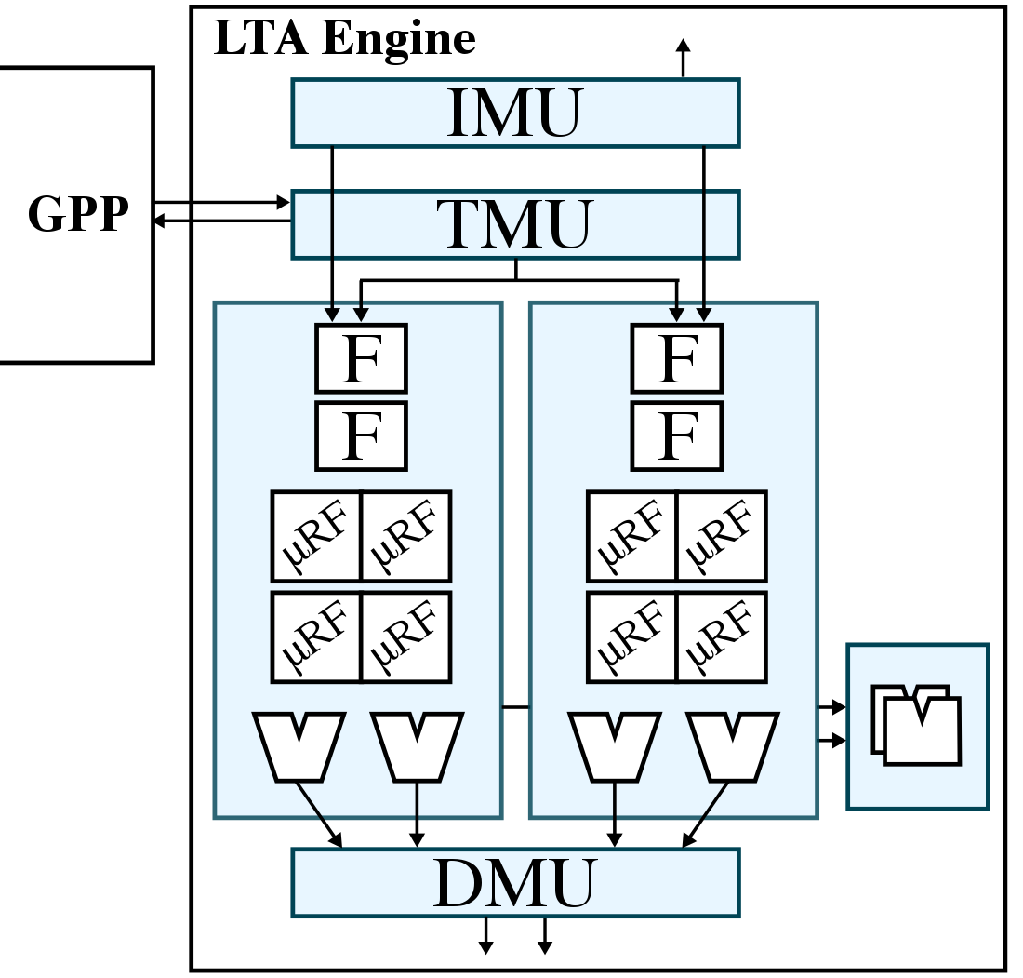
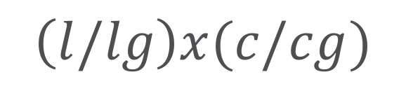
Task-Coupling Terminology
4/2x2/2
$$\left(l/lg\right)x(c/cg)$$

Slide 23
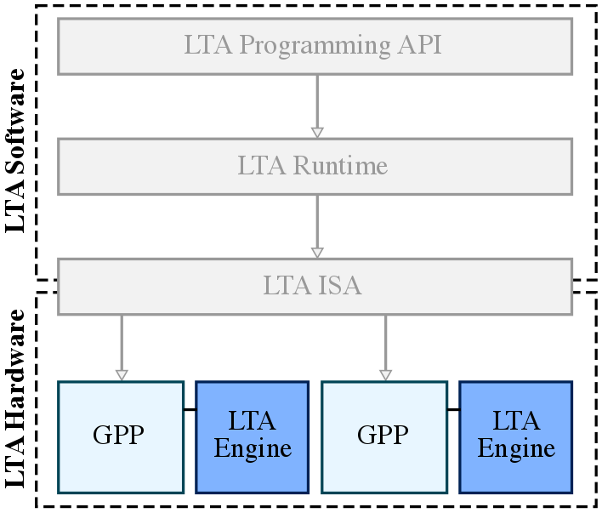
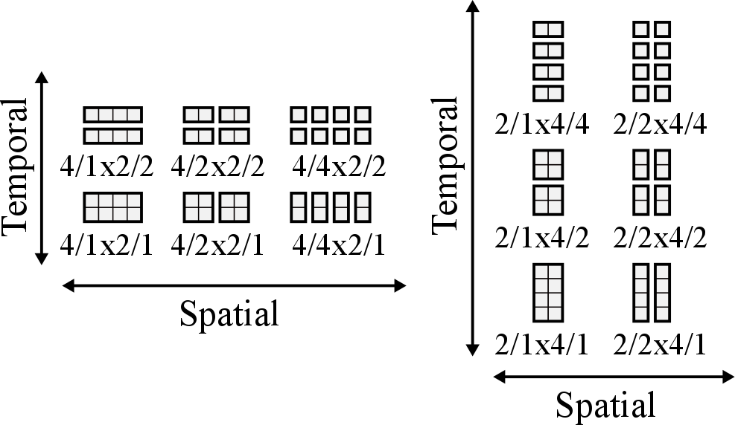
Task-Coupling Taxonomy

Slide 24
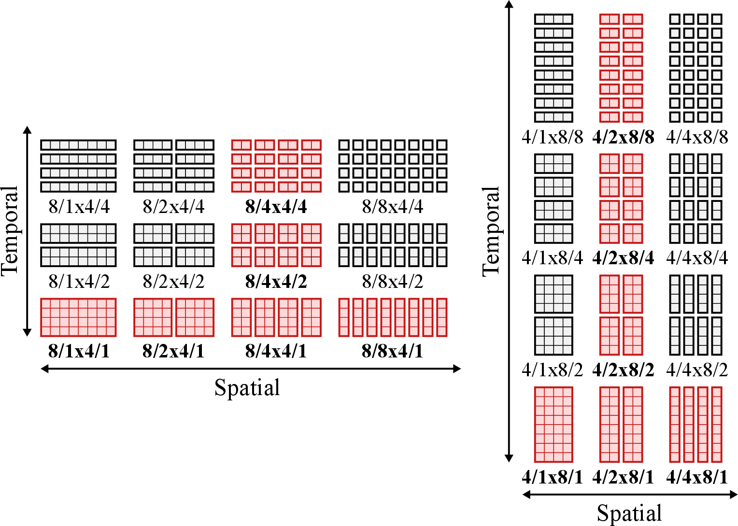
Task-Coupling Taxonomy

Slide 25
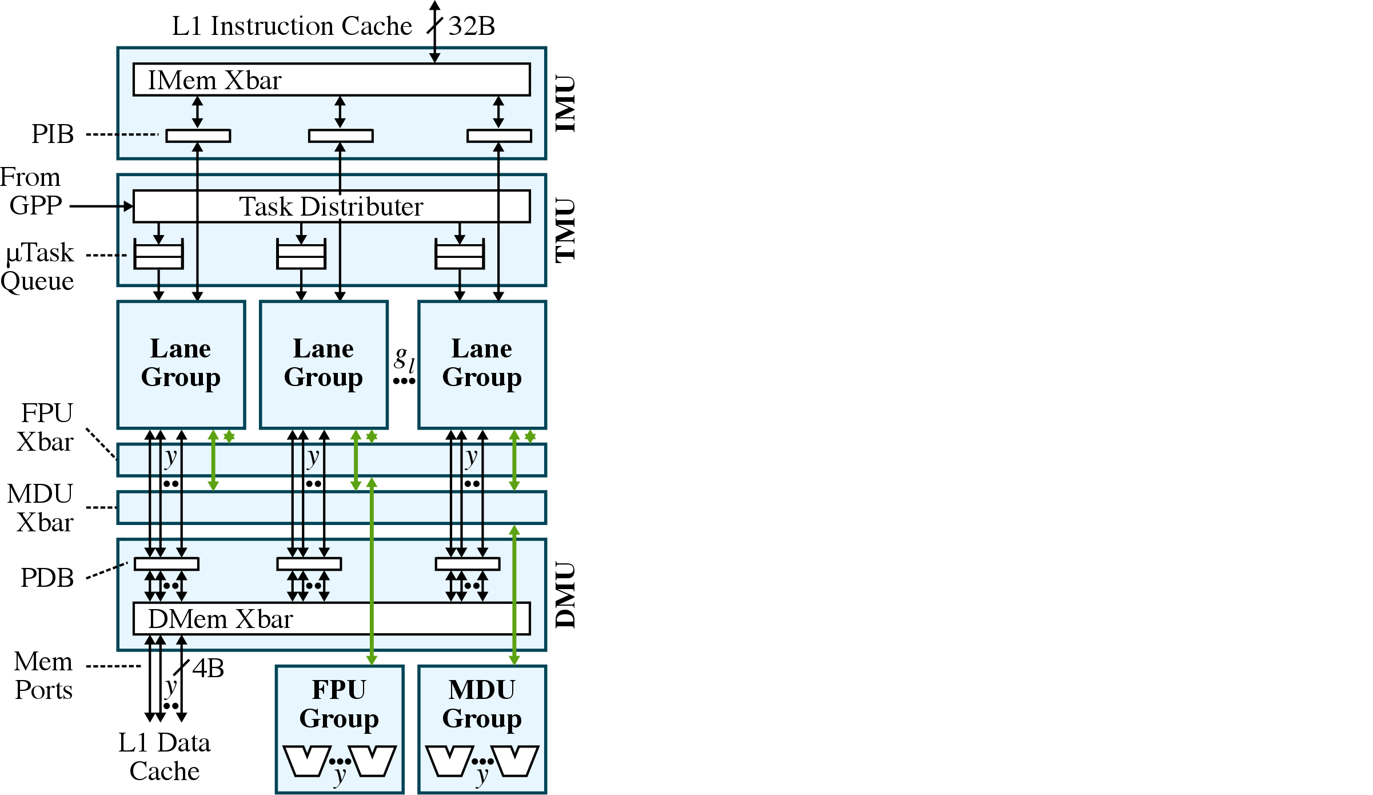
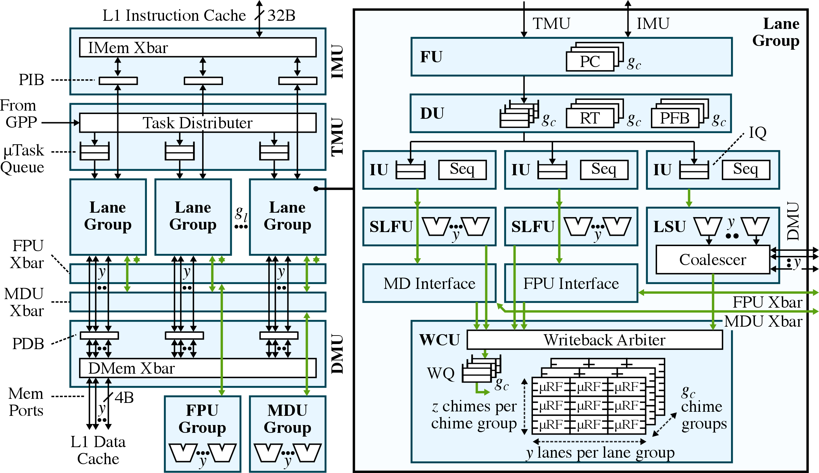
LTA Engine Template

Slide 26
Presentation Overview
App Dev Case Study
LTA Software
LTA Hardware
LTA Evaluation
Related Works
Conclusions

Slide 27
LTA Methodology
Ported 16 application kernels from PBBS and in-house benchmark suites with diverse loop-task parallelism
Scientific computing
N-body simulation, MRI-Q, SGEMM
Image processing
bilateral filter, RGB-to-CMYK, discrete cosine transform
Graph algorithms
breadth-first search, maximal matching, maximal independent set
Search/Sort algorithms
Radix sort, substring matching, dictionary

Slide 28
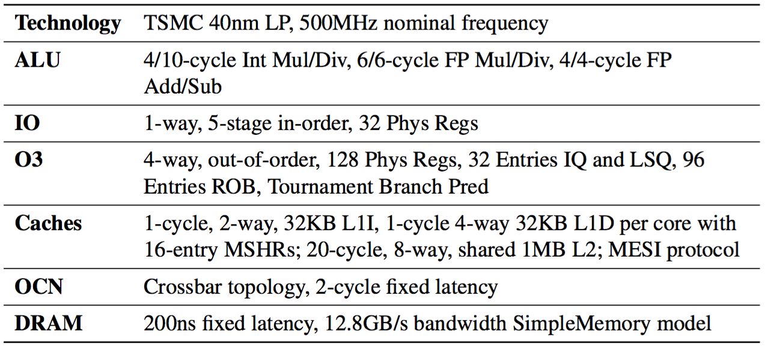
LTA Methodology
gem5 + PyMTL co-simulation for cycle-level performance
Component/event-based area/energy modeling
Uses area/energy dictionary backed by VLSI results
FG-SIMT RTL for lane groups
XLOOPS RTL for TMU and shared resources

Slide 29
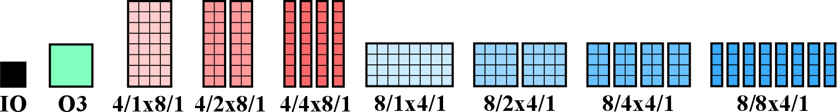
LTA Engine: Spatial Task Coupling: Performance
Notes:
Overall, performance from 4—5X vs. IO and 2—2.5X vs. O3.
Tighter coupling (less lane groups) improves perf on regular with high LLFU density. 27->19% on nbody, 26->17% on bilateral, 19->12% on mriq.
rgb2cmyk regular but no LLFUs. sgemm impacted by more stalls due to D$ misses. 26->52% on sgemm.
Looser coupling (more lane groups) improves perf on irregular with spatial control divergence. 11->18 rdups, 11->20 sarray, 6->10 strsearch, 10->16 bfs-d. Offset by increased conflicts in I$, but not noticeable until later.

Slide 30
LTA Engine: Spatial Task Coupling: Area
Notes:
Performance increases by factor of 4—6X, area increases by factor of 2—3X, so area efficiency is 2X.
Primary savings in sharing LLFUs and smaller D$ crossbar network.

Slide 31
LTA Engine: Spatial Task Coupling: Energy
tighter coupling
looser coupling
tighter coupling
Notes:
1.2—1.5X energy efficiency
Energy savings are mostly due to amortizing the frontend (I$ accesses and FU/DU/IU), more apparent on regular. Even irregular can benefit from cheaper PIB accesses.
D$ accesses with coalescing helps but offset by bigger crossbar network.

Slide 33
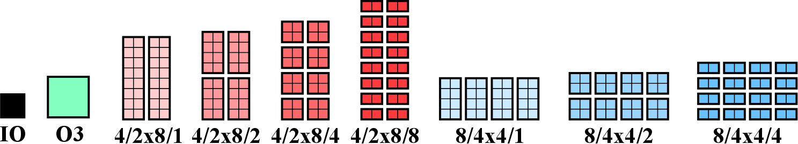
LTA Engine: Temporal Task Coupling: Performance
Notes:
Moderate coupling improves perf on regular/irregular.
Overall, loose temporal task coupling (more chime groups) marginal or worse performance. Due to I$ bottleneck with more task groups, 7->37% I$ stalls on rgb2cmyk.
On regular, reduced stalls due to D$ misses 10->4% on bilateral, 20->11% on mriq, 26->9% on sgemm.
On irregular, more chime groups does help hide microarchitectural latencies. 38->13% RAW stalls of strsearch.
Case studies: increasing uthread count better balance between number of chime groups and size of each chime group, and emulating more misses in L2 cache showed loose coupling much better at hiding D$ latencies.

Slide 35
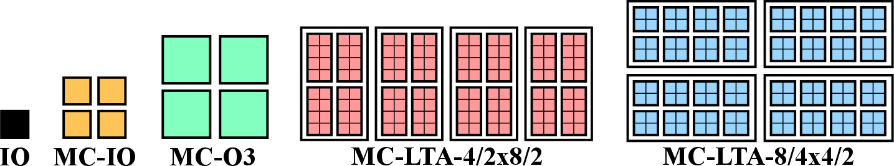
LTA Platform: Performance
area-normalized perf:
2.5X vs. MC-IO
1.7X vs. MC-O3
single-core LTA: 4.2—5.3X
multi-core IO: 3.1X
multi-core LTA: 13—16X
5.5X
3.0X
Notes:
4.2—5.3X speedup on intra-core, 3.1X speedup on inter-core (MC-IO): multiplicative speedup of 13—16X
vs. MC-IO: 5.5X raw perf, 2.5X area-norm perf, 1.2X eeff
vs. MC-O3: 3.0X raw perf, 1.7X area-norm perf, 2.5X eeff

Slide 36
LTA Platform: Productivity/Portability
CMP-AVX: memory alignment, eliminate control flow?
LTA: support for unaligned coalescing, divergence within task group
CMP-TBB: optimal grain size for load balancing?
LTA: LTA-aware task partitioning in runtime
CMP-TBB-AVX: disjoint inter- vs. intra-core abstractions?
LTA: loop task as common abstraction in SW and HW
MIC/GPGPU: re-tuning even with same SW framework?
LTA: same implementation can be used on GPP or LTA engine
MIC/GPGPU: struggles with irregular applications?
LTA: achieves multiplicative effects for both regular/irregular apps

Slide 37
Presentation Overview
App Dev Case Study
LTA Software
LTA Hardware
LTA Evaluation
Related Works
Conclusions

Slide 38
Related Works
Virtual ISAs
e.g.) AMD HSA, OpenCL, C++ AMP
DSLs
e.g.) Halide, OptiML, Delite
Work-stealing runtimes
e.g.) Cilk++, TBB
Libraries for productivity
e.g.) Thrust for CUDA
Accelerators for regular loop-task parallelism
e.g.) MICs, GPGPUs, FG-SIMT, Tarantula (vector-SIMD)
Accelerators for irregular (hybrid) loop-task parallelism
e.g.) XLOOPS, temporal SIMT (Echelon), variable warp size GPGPUs
GPGPU techniques
e.g.) dynamic warp subdivision/formation, static reconvergence

Slide 39
Previous Publications
J. Kim, C. Torng, S. Srinath, D. Lockhart, C. Batten. Microarchitectural Mechanisms to Exploit Value Structure in SIMT Architectures. ISCA 2013.
Fine-grain SIMT, tighter GPP integration, smaller vector length
J. Kim, C. Batten. Accelerating Irregular Algorithms on GPGPUs Using Fine-Grain Hardware Worklists. MICRO 2014.
Early experiments pushing SW abstractions to HW, inter- vs. intra- work distribution
J. Kim, S. Srinath, C. Torng, B. Ilbeyi, M. Wang, K. Al-Hawaj, S. Jiang C. Batten. Software/Hardware Co-Design to Improve Productivity, Portability, and Performance of Loop-Task Parallel Applications. Submitted to ASPLOS 2017.

Slide 40
Presentation Overview
App Dev Case Study
LTA Software
LTA Hardware
LTA Evaluation
Related Works
Conclusions

Slide 41
Contributions
Detailed analysis of 3P challenges in application development flow based on years of experience
LTA task-based work-stealing runtime and a new xpfor instruction for encoding loop tasks
LTA engine template with configurable spatial and temporal task coupling to accelerate loop tasks
Deep design-space exploration of task coupling and a 3P evaluation of the LTA platform

Slide 42
Avenues for Future Work
Generalizing to more forms of task parallelism
e.g.) recursion, nested parallelism
Heterogeneous LTA engines on multi-core system
Adaptive work scheduling using heuristics
Increasing energy efficiency with loose task coupling
Inter-lane-group memory coalescing
Extend PIB into shared L0 I$

Slide 43
Acknowledgements
BRG Members
Current: Shreesha, Chris, Berkin, Moyang, Shunning, Khalid
Previous: Derek, Jason Setter, Wei Geng, Scott McKenzie, Alvin Wijaya
CSL Members
Graduate Committee
Prof. Christopher Batten, Prof. Jose Martinez, Prof. Rajit Manohar
External collaborators
Prof. Martin Burtscher, Prof. Rupesh Nasre, Sripathi Pai
Prof. David Bindel
Funding
NDSEG Fellowship, NSF, AFOSR
Intel Corp., NVIDIA Corp., Synopsys Inc.

Slide 44
The End
Application development flow
LTA runtime + xpfor
LTA engine with spatial/temporal task coupling
Design space exploration + 3P evaluation of LTA platform

Slide 45
Presentation Overview
App Dev Case Study
LTA Software
LTA Hardware
LTA Evaluation
Related Works
Conclusions

Slide 46
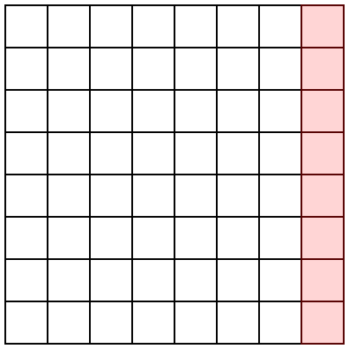


Matrix Alignment for Auto-Vectorization

Slide 47
LTA Programming API
void lta_function(
void* a, int start, int end, int step=1) {
args_t* args = static_cast<args_t*>(a);
int* dst = args->dst;
int* src0 = args->src0;
int* src1 = args->src1;
for (int i = start; i < end; i += step) {
if (src[i].cond0)
dst[i] = task0();
else if (src[i].cond1)
dst[i] = task1();
}
}
lta::parallel_for(0, size, [&](int i) {
if (src[i].cond0)
dst[i] = task0();
else if (src[i].cond1)
dst[i] = task1();
});
range step value
Notes:
Now let’s look at how these loop-tasks are exposed in the LTA programming API.
The lambda-based parallel_for was also explored, but unfortunately our cross-compiler does not support C++11 lambdas yet, so in this work I focus on the macro-based variant.

Slide 48




LTA Runtime
Notes:
Now that we know what utasks and uthreads are at a high-level, I would like to revisit the LTA runtime to identify how the utasks can interact negatively with the default task partioning algorithm.
In this example, I am showing a simplified version of a root task being partitioned into core tasks. The actual ranges of the tasks are not as important as the sizes of the tasks in the point I’m trying to illustrate here.
In the default partitioning scheme… we end up with 16 core tasks of various sizes. Now, let’s assume that we have 4 cores, each with 4 uthreads. Without going into too much detail for now, let’s further assume that these 4 uthreads must execute a task group in lock-step, such that the execution time of a core task of size 4 is roughly the same as that of a core task of size 1. In this scenario, an example execution might look like this, where each box is an equal unit of time and each column is a different core.
Remember that tasks are partitioned until the range size is less than equal to the core task size. In this example, the core task size is 4.
Notice that this is actually a bit inefficient and we’re leaving uthreads idle for entire blocks, since all utasks must be completed before the uthreads can be assigned a new set of utasks.
We can address this with an LTA-aware task partitioning scheme that dynamically reads the uthread count per core and partitions tasks so the range is a multiple of the uthread count. Here is an example of this scheme. Note that 20 -> 8/12, by dividing by half (10) and rounding to the nearest multiple of 4. In this case we end up with 11 core tasks… These core tasks are then executed on the same system like this.
Again this is assuming there isn’t too much variability in the amount of work across core tasks, and we’re making some simplifications, but it serves to get the main point across, which is that an LTA-aware task partitioning scheme can improve performance by compacting task groups into multiples of the uthread count (increasing hardware utilization).

Slide 49







Task Group Execution
Notes:
Ideally we would like an LTA engine that can accelerate regular and/or irregular applications. The key observation that I used to design the LTA engine is that task coupling in both space and time affect the performance, area, and energy efficiency of regular/irregular applications.
To see these impacts, I would like to look at an example of how an LTA engine with 8 uthreads executes a task group. As mentioned before, task groups are groups of utasks that need to executed in lock-step in both space and time. This LTA engine has 4 lanes which means that there are 2 chimes. Each instruction corresponds to all 8 uthreads and only needs to be fetched once. Half of the uthreads execute the instruction in the first chime, followed by the other half in the second chime…

Slide 50


Varying Spatial Task Coupling

Slide 51


Varying Temporal Task Coupling

Slide 52

Task-Coupling Terminology

Slide 53

Types of Control Divergence

Slide 54
LTA Runtime Validation
Experiments on Linux servers with Intel Xeon E5-2620 v3
x86 port of LTA runtime is competitive with Cilk++/TBB

Slide 55
LTA Engine: Spatial Task Coupling: Performance
Notes:
Overall, performance from 4—5X vs. IO and 2—2.5X vs. O3.
Tighter coupling (less lane groups) improves perf on regular with high LLFU density. 27->19% on nbody, 26->17% on bilateral, 19->12% on mriq.
rgb2cmyk regular but no LLFUs. sgemm impacted by more stalls due to D$ misses. 26->52% on sgemm.
Looser coupling (more lane groups) improves perf on irregular with spatial control divergence. 11->18 rdups, 11->20 sarray, 6->10 strsearch, 10->16 bfs-d. Offset by increased conflicts in I$, but not noticeable until later.

Slide 56
LTA Engine: Spatial Task Coupling: Area
Notes:
Performance increases by factor of 4—6X, area increases by factor of 2—3X, so area efficiency is 2X.
Primary savings in sharing LLFUs and smaller D$ crossbar network.

Slide 57
LTA Engine: Spatial Task Coupling: Energy
Notes:
1.2—1.5X energy efficiency
Energy savings are mostly due to amortizing the frontend (I$ accesses and FU/DU/IU), more apparent on regular. Even irregular can benefit from cheaper PIB accesses.
D$ accesses with coalescing helps but offset by bigger crossbar network.

Slide 58
LTA Engine: Temporal Task Coupling: Energy

Slide 59
LTA Engine: Temporal Task Coupling: Performance
Notes:
Overall, performance from 4—5X vs. IO and 2—2.5X vs. O3.
Tighter coupling (less lane groups) improves perf on regular with high LLFU density. 27->19% on nbody, 26->17% on bilateral, 19->12% on mriq.
rgb2cmyk regular but no LLFUs. sgemm impacted by more stalls due to D$ misses. 26->52% on sgemm.
Looser coupling (more lane groups) improves perf on irregular with spatial control divergence. 11->18 rdups, 11->20 sarray, 6->10 strsearch, 10->16 bfs-d. Offset by increased conflicts in I$, but not noticeable until later.

Slide 60

Application Characteristics

Slide 61

Application Statistics

Slide 63
Impact of LLFU Sharing with Temporal Task Coupling

Slide 64
Impact of uthread Count on Temporal Task Coupling

